Slide 1
WORK UPDATES PRESENTATION
FROM
Rishabh Kumar Srivastva
SAP ID- 52108159

Slide 2
CNN using Pytorch
Implementation of CNN using Pytorch done.
The architecture implemented is very similar to Lenet Architecture
The Architecture consists of 2 X (CONV => RELU => POOL layers), followed by 1X (FC => RELU layers), followed by 1 X Softmax layer for the output.
The Dataset used was Kuzushiji-MNIST dataset, or KMNIST
The KMNIST dataset consists of 70,000 images and their corresponding labels (60,000 for training and 10,000 for testing).
There are a total of 10 classes (meaning 10 Hiragana characters) in the KMNIST dataset, each equally distributed and represented. Our goal is to train a CNN that can accurately classify each of these 10 characters.

Slide 3
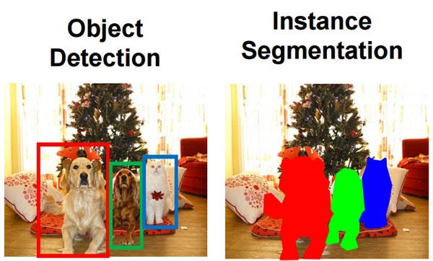
Segmentation
What is Image Segmentation
By using image segmentation techniques, you can divide and group-specific pixels from an image, assign them labels and classify further pixels according to these labels. You can draw lines, specify borders, and separate particular objects (important components) in an image from the rest of the objects (unimportant components).
Object Detection v/s Image Segmentation
Object detection builds a bounding box corresponding to each class in the image. But it tells us nothing about the shape of the object. We only get the set of bounding box coordinates. We want to get more information – this is too vague for our purposes.
Image segmentation creates a pixel-wise mask for each object in the image. This technique gives us a far more granular understanding of the object(s) in the image.

Slide 4
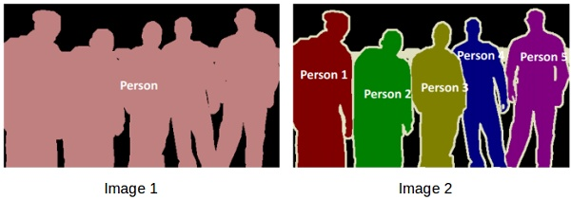
2 Types of Segmentation Problems
In image 1, every pixel belongs to a particular class (either background or person). Also, all the pixels belonging to a particular class are represented by the same color (background as black and person as pink). This is an example of Semantic segmentation
Image 2 has also assigned a particular class to each pixel of the image. However, different objects of the same class have different colors (Person 1 as red, Person 2 as green, background as black, etc.). This is an example of Instance segmentation
In above figure, If there are 5 people in an image, semantic segmentation will focus on classifying all the people as a single instance. Instance segmentation, on the other hand will identify each of these people individually.

Slide 5
SEAFORMER: SQUEEZE-ENHANCED AXIAL TRANSFORMER
The landscape of many computer vision tasks (e.g., semantic segmentation), which has been overwhelmingly dominated by CNNs, recently has significantly revolutionized. However, the computational cost and memory requirement render these methods unsuitable on the mobile device, especially for the high-resolution per-pixel semantic segmentation task. To, solve these issues we have SeaFormer.
SeaFormer (squeeze-enhanced Axial Transformer) is a mobile-friendly image segmentation model that is built using transformers. It reduces the computational complexity of axial attention to achieve superior efficiency on mobile devices.

Slide 6
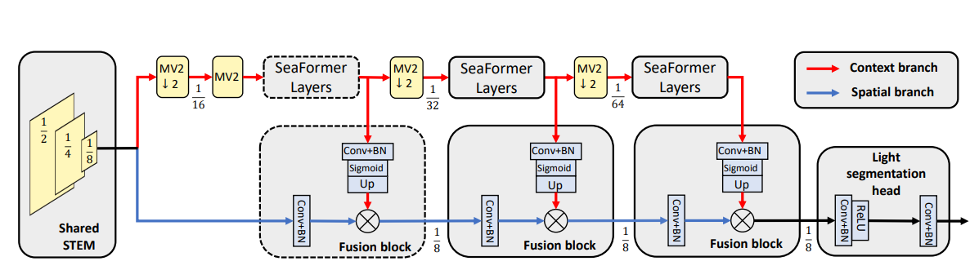
STEM branch: . It consists of one regular convolution with stride of 2 followed by four MobileNet blocks where stride of the first and third block is 2
MobileNetV2 : Mobilenet as a backbone can achieve fast object detection optimized for mobile devices. This class of models is based on a simplified architecture that uses depth-separable convolutions to build lightweight deep neural networks. It decomposes standard convolution into depth convolution and a 1×1 convolution known as point convolution. A standard convolution has one step for both filtering and combining the inputs into a new set of outputs. But the depth-separable convolution splits it into two layers, a separate layer for filtering and a separate layer for combining. This factorization drastically reduces the computation and model size.

Slide 7
Seaformer Layers: The core building block is what they call squeeze-enhanced axial (SEA) attention. This block acts like a data compressor to reduce the input size. It seeks to squeeze (pool) the input feature maps along both the horizontal/vertical axis into a compact column/row and then computes self-attention. Here, they have first implemented horizontal squeeze by taking average of query feature map on the horizontal direction. In the same way, the vertical squeeze on the vertical direction is also done.
DataSet: ADE20K Zhou et al. (2017), CityScapes Cordts et al.(2016). ADE20K dataset covers 150 categories, containing 25K images that are split into 20K/2K/3K for Train, val and test. CityScapes is a driving dataset for semantic segmentation. It consists of 5000 fine annotated high-resolution images with 19 categories.

Slide 9
SEAFORMER Implementation
Libraries Installed and configured
Install PyTorch
!pip install -U torch==1.12.0+cu116 torchvision==0.13.0+cu11.6 –f https://download.pytorch.org/whl/torch_stable.html
Install dependencies required to create the environment: Dependencies between Pytorch and mmcv were successfully resolved.
!pip install mmcv-full==1.6.0 -f https://download.openmmlab.com/mmcv/dist/cu116/torch1.12/index.html
pip install timm==0.3.2
pip install mmsegmentation
Install MMDetection from the source repository : MMDetection is a toolbox containing many pre-built models and each model has its own architecture, this toolbox defines a general architecture that can adapt to any model.

Slide 10
OpenCV and Face Detection
Topics Covered & Implemented
Image Reading & plotting using matplotlib
Image Writing
Image Resizing
Read and write Video
Color Conversion of Image/frames of video
Edge Detection using Canny Algorithm
Face Detection using Haar-Cascade Classifiers

Slide 11
Future Scope of Work
Read up on Vision Transformers
Architectural study of Seaformer
Implementation of Seaformer Model(ongoing)

